Slide 1

Incorporating Prior Knowledge on Speech Production Mechanism into Neural Speech Waveform Generation 深層音声波形生成における音声生成過程に関する事前知識の導入
[2021/2/18]
Yi-Chiao Wu
Toda Lab, Nagoya University, Japan
Notes:
[Opening]
Hello everyone, I’m Wu Yi-Chiao from Nagoya University, Japan. Today, I would like to introduce my PhD research, Incorporating Prior Knowledge on Speech Production Mechanism into Neural Speech Waveform Generation.

Slide 2
Outline
Introduction of speech generation
Challenge of speech generation
Quality, robustness, controllability, efficiency
Proposed method
Waveform constraint
Pitch-adaptive neural network
Conclusion
Notes:
[Outline]
This is my outline.
First, I will introduce the background knowledge of speech generation.
Secondly, I will highlight 4 challenges of speech generation.
Thirdly, I will present my proposed methods.
Last, I will give a conclusion.

Slide 3
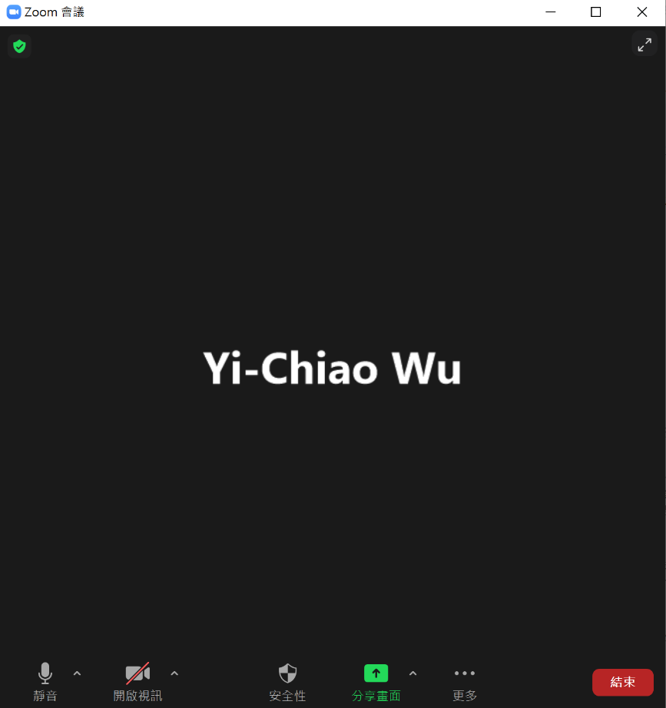
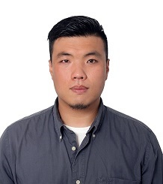
Speech Waveform Generation
Information conveyed in speech signals
Speaker identity (Who)
Content (What)
Environment (Where)
Emotion …
Generating speech with desired information
Voice conversion (VC): specific speaker identity
Noise reduction: reduce background noise
Text-To-Speech (TTS): specific content
I’m a researcher!
Notes:
[Introduction]
Speech signals convey much information such as the speaker identity, the content, the environment, and the emotion.
Speech generation is a technique to generate speech with the desired information. For example, the speech with a target speaker identity is generated in Voice conversion, the speech with reduced background noise is generated in Noise reduction, and the speech with specific contents is generated in TTS.

Slide 4
Speech Generation Flow
Analysis
Convert inputs to acoustic features
VC: source speech → acoustic features
TTS: text → acoustic features
Manipulation
Modify specific speech information
Synthesis
Generate speech waveforms based on
acoustic features
Research
focus
Notes:
[Flow]
A speech generation flow includes three stages.
The first is analysis. The inputs such as source speech in VC and text in TTS are converted into acoustic features.
The second is manipulation. The desired information is manipulated by modifying the corresponding speech components of the acoustic features.
The last is synthesis. The speech waveforms are generated based on these acoustic features.
I focus on the synthesis stage in my Ph.D. research.

Slide 5
Challenge of Speech Generation
Quality
Naturalness of generated speech
Similarity to target speech
Robustness
Robust to distorted acoustic features
Controllability
Acoustic component controllability
Efficiency
Real-time and streaming generation
Research
focus
Notes:
[Challenge]
4 challenges of speech generation are explored in my Ph.D. research.
The first is Quality such as the naturalness of the generated speech and its similarity to the target speech.
The second is Robustness. Since the manipulated acoustic features usually suffer from distortion, the robustness to the distorted acoustic features is challenging.
The third is the flexibility to control each speech component.
The last is generation efficiency such as real-time and steaming generation.
The proposed techniques in this research focus on Robustness and Controllability.

Slide 6
Speech Production Mechanism
Vocoder (voice coder) [H. Dudley, 1939]
Convert speech to acoustic features
Generate speech based on acoustic features
Source filter model [R. McAulay+, 1986]
Excitation generation
Voiced: vocal fold vibration
Unvoiced: w/o vibration
Modulation
Vocal and nasal tracts resonance
Transmission
Lip radiation
Notes:
[Speech production]
Before going through the details of each challenge, I would like to introduce the speech modeling techniques.
A vocoder, which means a voice coder, converts speech to acoustic features such as spectral and prosodic features in the analysis stage and generates speech based on these acoustic features in the synthesis stage.
The source filter model is one of the most general speech production models, which models the human vocal system with 3 parts.
In excitation generation, the voiced excitation signals are generated using vocal fold vibrations, and the unvoiced excitation signals are generated without vocal fold vibrations.
In modulation, a time-variant spectral filter models the vocal and nasal tracts resonance.
In transmission, a time-invariant high-pass filter is adopted to model the lip radiation.

Slide 7
Vocoder
Research focus
Notes:
[Vocoder]
Currently, there are two main vocoder categories, source-filter and unified vocoders.
A source-filter vocoder includes an excitation generation module and a resonance filtering module. The inputs are acoustic features and the output is speech waveform.
For conventional vocoders, both modules are parametric.
Because of the powerful modeling capacity, the excitation module, the filter modules, or both modules are replaced by neural networks in recent work.
On the other hand, a unified vocoder directly models speech waveform with a single neural network. The inputs can be acoustic or linguistic features and the output is also speech waveform.
In my Ph.D. research, I focus on improving the unified vocoders.

Slide 8
Quality
Conventional parametric vocoder
Phase information and temporal details are discarded during analysis-synthesis
Buzzy noise and unnatural sounds
Neural vocoder
Directly modeling raw waveform
Reconstruct phase and details well
WaveNet [A. Oord+, 2016]
Parallel WaveGAN [R. Yamamoto+, 2020]
Notes:
[Quality]
Although conventional parametric vocoders are simple and efficient, the phase and temporal details are usually discarded during the analysis and synthesis, which will cause buzzy noise and unnatural sounds.
Recently, many neural vocoders have been proposed to directly model raw waveforms, which model the phase and details well. In my Ph.D. research, I explore the WaveNet and parallel WaveGAN models, which are introduced in chapters 2 and 3 of my thesis.

Slide 9
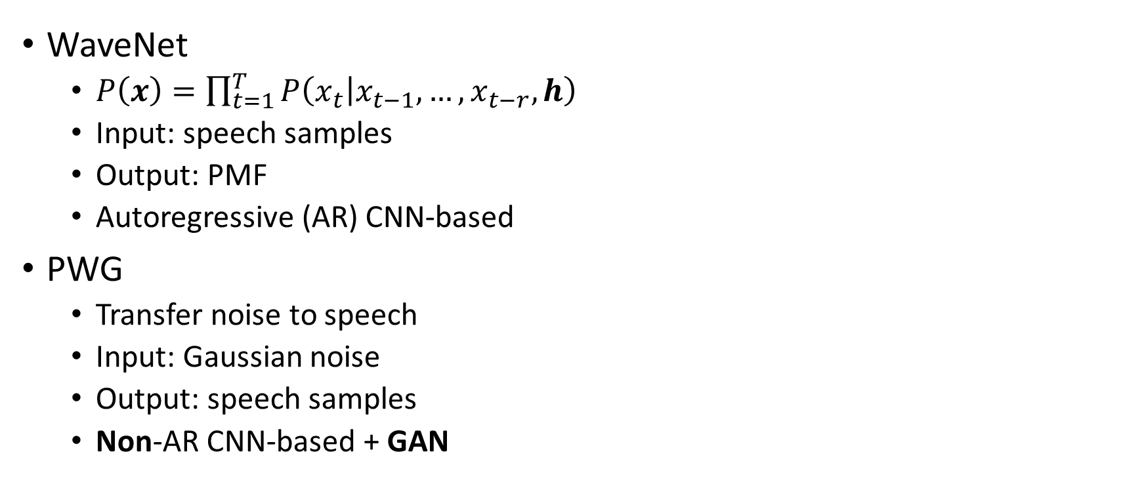
WaveNet and Parallel WaveGAN
WaveNet
$P\left(x\right)=\prod_{t=1}^{T}{P\left(\left.x_{t}\right|x_{t−1},…,x_{t−r},h\right)}$
Input: speech samples
Output: PMF
Autoregressive (AR) CNN-based
PWG
Transfer noise to speech
Input: Gaussian noise
Output: speech samples
Non-AR CNN-based + GAN
Notes:
[WN & PWG]
WaveNet models the probability distribution of each speech sample conditioned on previous samples and acoustic features h.
Parallel WaveGAN (PWG) directly transfers Gaussian noise into speech samples conditioned on acoustic features.
The inputs of WaveNet are previous speech samples, and the input of PWG is Gaussian noise.
The output of WaveNet is the Probability Mass Function of each sample, and the PWG directly outputs speech samples.
WaveNet is an autoregressive CNN-based model, and PWG is a non-autoregressive CNN-based model with a GAN structure.

Slide 10
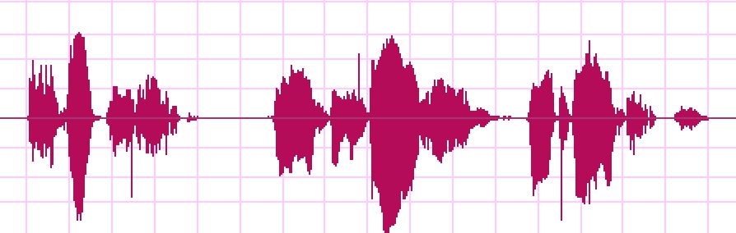

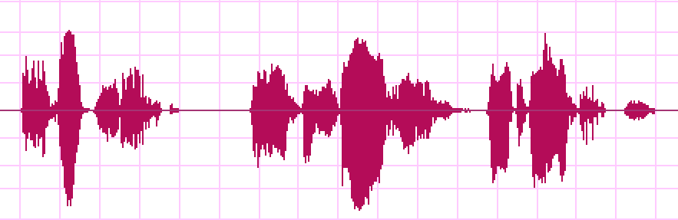
Robustness
Distorted acoustic features
Prediction errors of NN-vocoders
Directly modeling speech waveform
Few prediction errors cause markedly discontinuity
Significant perceptual degradation
Collapsed
Refined
Notes:
[Robustness]
Since the input acoustic features are usually predicted by other models, the unnatural acoustic features usually cause prediction errors of the neural vocoders. Because the neural vocoders directly model speech waveforms, few prediction errors will cause marked discontinuities, which result in significant perceptual quality degradation.
As shown in this figure, there are some unnatural impulses, and we call it a collapsed speech problem. The utterance including collapsed speech is like that.
We can easily find several discontinuous segments in this utterance.
In chapter 4 of my thesis, I propose a waveform domain constraint using the prior knowledge of speech continuity to tackle this collapsed speech problem, and the refined utterance is like that, which is continuous.

Slide 11
Controllability
Unified vocoder
Data-driven nature
Without many prior speech knowledge
Speech periodicity and continuity
Lack the controllability of speech components
Unexpected output
Limited pitch controllability
F₀ is not in the observed F₀ range of training data
Unseen acoustic feature pair
 | Normal | 2×F₀
Expected
PWG
QPPWG
Notes:
[Controllability]
Furthermore, the data-driven nature without much prior speech knowledge such as speech periodicity and continuity make these vocoders lack the controllability of speech components, which usually causes unexpected output problem.
In chapters 5 and 6 of my thesis, I explore the limited pitch controllability problem of WaveNet and PWG.
Specifically, if the input fundamental frequency (F0) is not in the observed F0 range of the training data, the pitch of the PWG-generated speech is usually inconsistent with the input F0.
Here is an example. First, I play the speech with normal F0.
The first utterance is natural speech. The second utterance is PWG-generated. The third utterance is the proposed QPPWG-generated speech. We can find that both PWG- and QPPWG-generated utterances are natural.
Secondly, I play the speech with doubled F0. The first utterance is what we expected. The second utterance is PWG-generated. We can find that not only the quality is lower but also the pitch is much lower than what we expected. The third utterance is QPPWG-generated. We can find that although the quality is still slightly lower, the pitch is consistent with what we expected.

Slide 12
Generation Efficiency
Practical application
Speech assistant
Navigation devices
Real-time generation
Streaming generation
Low latency
Low computation and storage capacity requirements
Mobile device
Notes:
[Efficiency]
For the practical applications of speech generation, generation efficiency is important.
The basic requirement is real-time generation.
The advanced requirement is not only real-time but also streaming generation with very low latency.
Moreover, the low computation and storage capacity requirements are also essential for mobile devices.
In chapter 6 of my thesis, I explore the improvements of PWG, and the proposed QPPWG vocoder only achieves the basic real-time generation.

Slide 13
Waveform Constraint: LPCDC [Y.-C. Wu+, 2018]
Prior knowledge of speech continuity
Reference waveform samples generation
The outputs of conventional vocoder (WORLD) are usually stable
Samples relationship extraction
Linear prediction coding (LPC)
LPC distribution constraint (LPCDC)
Gaussian distribution
Mean: LPC predict value
Variance: variance of prediction errors
WaveNet output PMF
LPCDC PMF
Notes:
[LPCDC]
After the overview of my thesis, I would like to first introduce the proposed waveform constraint. We take advantage of the speech continuity to constraint the output PMF of WaveNet. Specifically, if we can find a reference without the discontinuous problem, we can extract the continuous relationships among reference samples to guide WaveNet generation.
Since the outputs of conventional parametric vocoder such as WORLD are usually stable, we adopt the WORLD-generated speech as the reference.
We also adopt the basic linear prediction coding (LPC) technique to extract sample relationships.
Since the proposed method is general, adopting other advanced reference and speech coding is possible.
After that, we can derive a PMF with a normal distribution. The mean is the LPC predicted value, and the variance is the variance of the prediction errors. We call this PMF an LPC distribution constraint (LPCDC), and the final output is the WaveNet-predicted PMF multiplied by the LPCDC PMF.

Slide 14
Segmentally Detection: CSSD [Y.-C. Wu+, 2018]
Error propagation from WORLD to WN
Oversmoothing from LPCDC
Collapsed speech segment detection
Collapsed speech occurs in a short segment
Segmentally detect collapsed speech
Only apply LPCDC to the detected segments
Notes:
[CSSD]
However, since the LPC coefficients are extracted from the WORLD-generated speech, the errors will propagate to WaveNet with the LPCDC. The oversmoothing problem of LPC will also degrade the quality of the WaveNet-generated speech.
To tackle this problem, because the collapsed speech usually occurs in a few samples, we propose a collapsed speech segment detection, CSSD, technique to segmentally detect the collapsed speech and only apply the LPCDC to the detected segments. This framework restricts the negative effects from LPCDC in very short time slots.
As shown in this figure, WaveNet segmentally generates speech based on the input acoustic features, and the generated segments will be checked by the CSSD with the WORLD-generated reference speech. If a collapsed speech is detected in this segment, WaveNet will regenerate this segment with LPCDC.

Slide 15
Mean Opinion Score of Speech Quality
Score: 1(lowest)–5(highest)
Collapsed speech causes marked quality degradation
LPCDC introduces negative effects
CSSD + LPCDC segmentally suppresses collapsed speech
Notes:
[MOS]
We conducted a subjective mean opinion score evaluation to show the effectiveness of our proposed method.
First, we label the generated utterances to divide them into two subsets. One is the collapsed-free set and another one is the collapsed set.
According to the MOS results, we can find that the collapsed speech significantly degrades speech quality, and If we only apply LPCDC, the speech quality even becomes worse because of the error propagation.
However, if we apply LPCDC with CSSD, the speech quality becomes much better.
The subjective results show the effectiveness of our proposed method to detect and suppress the collapsed speech.

Slide 16
Speaker Similarity Evaluation
Are the generated speech and natural speech from the same person?
Similarity score = same (%) + maybe the same (%)
CSSD +LPCDC maintains the same speaker similarity
Notes:
[Similarity]
We also conducted subjective similarity evaluations.
At each trial, we play a target utterance and a generated utterance to a listener and ask the listener whether the two utterances are from the same person or not.
There are four choices, the same, maybe the same, maybe different, and different.
The similarity score is the summation of the same and maybe the same.
According to the results, we can find that WaveNet achieves higher speaker similarity than the conventional WORLD vocoder, and applying the proposed CSSD and LPCDC to WaveNet maintains the same speaker similarity.

Slide 17
Receptive Field Extension: DCNN
Receptive field
A region of input space affecting the neural network output
Receptive field size is highly related to the model capacity
Dilated CNN (DCNN) [F. Yu+, 2016]
Convolution with time delays (gaps, dilation size)
4
0
2
0
1
0
Notes:
[DCNN]
Before I introduce my second work, I would like to introduce a core technique, dilated CNN (DCNN), of WaveNet and PWG.
As we know, a receptive field of a CNN-based model is a region of input space affecting the model output, and the receptive field size is highly related to the model capacity.
To efficiently enlarge the receptive field size, both WaveNet and PWG adopt DCNN, which is a convolution with time delays, and the size of time delays is the dilation size.
I take a model with three hidden CNN layers and each CNN has a size two kernel as an example.
For the first CNN layer, we set the dilation size to one, so the kernel will sample the current input and the first past input.
For the second CNN layer, we set the dilation size to two, so the kernel still samples the current input but skips the first past input and samples the second past input.
For the third CNN layer, because the dilation size is four, the kernel samples the current input and the fourth past input.
With stacked DCNN layers, the models can efficiently extend the receptive field.

Slide 18
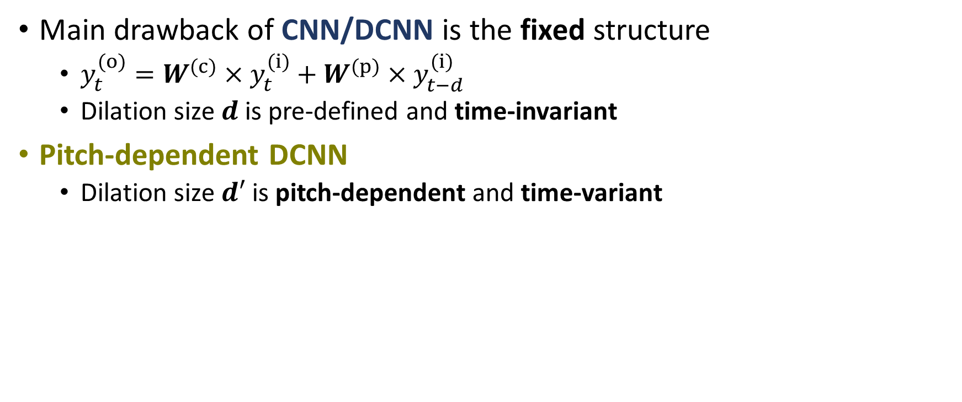
PDCNN
Main drawback of CNN/DCNN is the fixed structure
$y_{t}^{(o)}=W^{(c)}×y_{t}^{(i)}+W^{(p)}×y_{t−d}^{(i)}$
Dilation size $d$ is pre-defined and time-invariant
Pitch-dependent DCNN
Dilation size $d′$ is pitch-dependent and time-variant
Notes:
[PDCNN]
However, we know that the main drawback of CNN/DCNN is the fixed geometric structure.
Specifically, convolution with a size two kernel can be formulated like this formula. “y” denotes feature map, “i” denotes input, and “o” denotes output. “W^(c)” and “W^(p)” are trainable weight matrices for current and past samples, respectively. “t” is the time index, and “d” is the dilation size.
For CNN, “d” is set to one.
For DCNN, “d” is pre-defined and time-invariant.
To flexibly control network architecture according to input F0, the dilation size “d’” of our proposed PDCNN is pitch-dependent and time-variant.
That is, the original dilation size “d” is multiplied by a time-variant pitch-dependent scale “E” to get the dilation size “d’” of PDCNN.

Slide 19
Quasi-Periodic Signal Modeling
Simultaneous model periodic and aperiodic components
Cascaded network of fixed and adaptive blocks
Fixed blocks w/ DCNNs
Model the aperiodic components with the nearest samples (short-term correlations)
Network architecture is fixed
Adaptive blocks w/ PDCNNs
Model the periodic part with prior F₀ knowledge (long-term correlations)
Network architecture is dynamically changed
Notes:
[QP]
Since speech has periodic and aperiodic components, we propose a QP structure to simultaneously model them.
The QP structure is composed of cascaded fixed and adaptive blocks.
The fixed blocks with fixed network architectures adopt DCNNs to model the short-term correlations of aperiodic components.
The adaptive blocks adopt PDCNNs to model the long-term correlations of periodic components, and its network architecture is dynamically changed according to the input F0.

Slide 20
QPNet [Y.-C. Wu+, 2019]
Apply the QP structure to WaveNet
Difference w/ WaveNet
Cascaded modules
Adaptive block w/ PDCNN
1/2 model size
Drawback
Generation is still slow
Notes:
[QPNet]
We first apply the QP structure to the WaveNet vocoder.
The block diagram of QPNet is shown in this figure.
The main difference from WaveNet is that QPNet replaces several fixed blocks of WaveNet with the proposed adaptive blocks to improve its pitch controllability and modeling efficiency.
With the proposed QP structure, QPNet achieves similar speech quality and higher pitch accuracy than WaveNet while the model size is halved of that of WaveNet. However, although the model size is reduced by 50%, it is still large.
The large network and AR-mechanism make the generation is still far away from real-time.

Slide 21
QPPWG [Y.-C. Wu+, 2020]
Apply the QP structure to the generator of PWG
Inherit from PWG
Multi-resolution STFT
Discriminator
Differences w/ QPNet
Non-AR
Gaussian noise input
Raw waveform output
1/20 model size
Notes:
[QPPWG]
Therefore, we apply the QP structure to parallel WaveGAN (PWG), which is a compact and non-AR generative model. Since the discriminator and multi-STFT losses show the effectiveness in PWG training, the proposed QPPWG modifies only the generator.
Even if the model size of PWG is only 3% of WaveNet, QPPWG still further reduces 30 % model size of PWG while achieving similar speech quality but higher pitch controllability.
On the other hand, compared with QPNet, the main difference of QPPWG is the Non-AR mechanism, Gaussian noise input, raw waveform output, and only 5 % model size.

Slide 22
Mean Opinion Score of Speech Quality
Score: 1(lowest)–5(highest)
QPNet/QPPWG outperform the same sized WN/PWG
QPNet/QPPWG comparable to the larger sized WN/PWG
QPPWG outperform the 1.5 sized PWG w/ scaled F₀
Notes:
[MOS]
For speech quality, we conducted MOS tests for normal F0 and scaled F0 scenarios.
According to the results, we can find that QPNet and QPPWG respectively outperform the same sized WaveNet and PWG and achieve comparable speech quality to the larger sized WaveNet and PWG in all scenarios.
QPPWG even outperforms the 1.5 sized PWG in scaled F0 scenarios.

Slide 23
ABX of Pitch Accuracy
X: WORLD-generated reference
QPNet attains perceptually higher pitch accuracy than WN
QPPWG attains perceptually higher pitch accuracy than PWG
Notes:
[ABX]
We also conducted ABX tests to evaluate the perceptual pitch accuracy.
At each trial, we play a reference utterance and two test utterances and ask the listeners to choose which test utterance’s pitch is more consistent with the reference.
Since we don’t have the ground truth of natural speech with scaled F0, we take WORLD-generated speech as the reference.
According to the results, we can find that QPNet attains perceptually higher pitch accuracy than WaveNet, and QPPWG also attains perceptually higher pitch accuracy than PWG.

Slide 24
Real-Time Factor
CPU (2.60 GHz, 32 threads)
Number of blocks ↓ ➔ Generative speed ↑
GPU
Feature map indexing degrades the CNN parallelization
Complexity ↑ ➔ Generative speed ↓
 | PWG_20 | PWG_30 | QPPWG_20
Intel Xeon Gold 6142 | 0.474 | 0.579 | 0.512
Nvidia TITAN V | 0.011 | 0.016 | 0.020
Notes:
[RTF]
Since our goal is to build a real-time system, we also evaluated generation speed in real-time factor.
First, we tested on a CPU with 2.6 GHz and 32 threads.
According to the result, we can find that because of the reduced model size, the generation speed of QPPWG is faster than that of the original PWG. On the other hand, when tested on a GPU, because the QP structure degrades the CNN parallelization, the generation speed of QPPWG is slower than the original PWG.
However, since the generation is much faster than real-time, the increased time is insignificant.

Slide 25
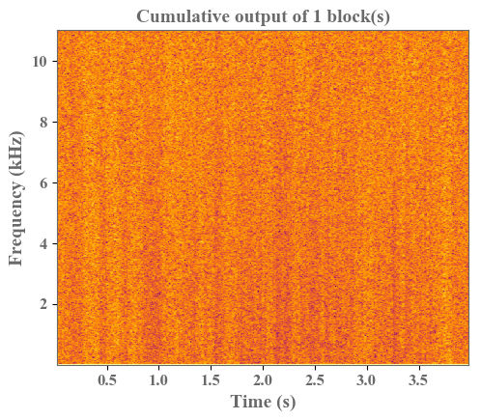
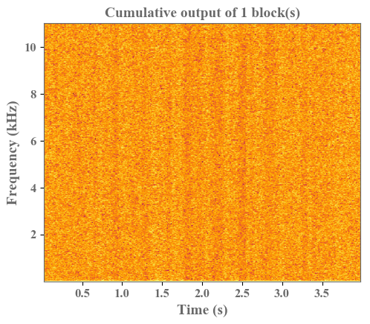
Understanding of QP Structure
Visualized intermediate outputs
Cumulative output of skip connections
PWG
QPPWG (adaptive → fixed)
Notes:
[QPPWGaf]
To understand the internal generation mechanism, we visualize the intermediate outputs.
According to the results, we can find that PWG gradually generates both harmonic and non-harmonic components.
However, the QPPWG model with an adaptive-to-fixed order first generates the harmonic components and then the non-harmonic components.
That is, the first 10 adaptive blocks focus on modeling pitch-related components and the last 10 fixed blocks focus on modeling spectral-related components.

Slide 26
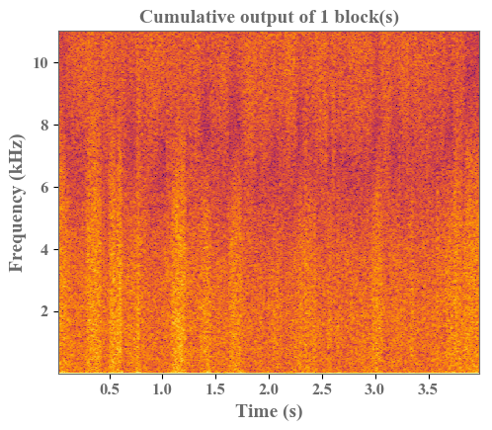
Understanding of QP Structure
Adaptive ➔ modeling source signal
Fixed ➔ spectral filtering
QPPWG (fixed → adaptive)
QPPWG (adaptive → fixed)
Notes:
[QPPWGfa]
In contrast to the QPPWG model with an adaptive-to-fixed order, the QPPWG model with a fixed-to-adaptive order first focuses on non-harmonic components and then generates harmonic components.
The visualized results confirm our assumption that the adaptive blocks modeling the pitch-related components with long-term dependencies, and the fixed blocks modeling the spectral-related components with short-term dependencies.

Slide 27
Research Summary
Neural vocoder
WaveNet
Parallel WaveGAN
Collapsed speech
Prior knowledge of speech continuity
Pitch controllability
Prior knowledge of speech periodicity
Real-time generation
Non-autoregressive (Non-AR) mechanism
Notes:
[Summary]
To summarize, my research first starts with an autoregressive Neural vocoder, WaveNet.
Secondly, I propose a waveform constraint to tackle the collapsed speech problem using the prior knowledge of speech continuity.
Thirdly, I improve the pitch controllability using the prior knowledge of speech periodicity.
Last, to achieve real-time generation, I applied the proposed methods to a non-autoregressive neural vocoder, parallel waveGAN.

Slide 28
Performance Improvement
LPCDC w/ CSSD
Improve robustness to distorted acoustic features
QPNet/QPPWG w/ PDCNN and QP structure
Higher pitch controllability
Smaller model size
Comparable speech quality
Notes:
[Inprovements]
The proposed waveform constraint including LPCDC and CSSD greatly improve the robustness to distorted acoustic features.
The proposed QPNet and QPPWG achieve higher pitch controllability and comparable speech quality using more compact models.

Slide 29
Conclusion
Contribution
Propose a waveform-based constraint to improve the robustness of neural vocoders based on the prior knowledge of speech continuity
Incorporate prior pitch information into neural networks to propose pitch-adaptive models with time-variant network architectures
Show the effectiveness of introducing speech knowledge to neural speech waveform generation
Future work
Streaming generation
Low computation and storage capacity requirements
Emotional speech generation
Notes:
[Conclusion]
The contribution of my research is that we propose a waveform-based constraint to improve the robustness of neural vocoders based on the prior knowledge of speech continuity
We incorporate prior pitch information into neural networks to propose pitch-adaptive models with time-variant network architectures.
The experimental results show the effectiveness of introducing speech knowledge to neural speech waveform generation.
For future work, there are several directions such as streaming generation, execution on mobile devices, and emotional speech generation.

Slide 30
Publication
LPCDC w/ CSSD
Y. -C. Wu et al. “The NU non-parallel voice conversion system for voice conversion challenge 2018”, in Proc. Odyssey, 2018.
Y. -C. Wu et al. “Collapsed speech generation and suppression for WaveNet vocoder ,” in Proc. Interspeech, 2018.
Y. -C. Wu et al. “Non-parallel voice conversion system with WaveNet vocoder and collapsed speech suppression,” IEEE Access, 2020.
QPNet
Y.-C. Wu et al. “Quasi-Periodic WaveNet vocoder: a pitch dependent dilated convolution model for parametric speech generation ,” in Proc. Interspeech, 2019.
Y.-C. Wu et al. “Statistical voice conversion with Quasi-Periodic WaveNet vocoder ,” in Proc. SSW10, 2019.
Y.-C. Wu et al. “Quasi-Periodic WaveNet vocoder: an autoregressive raw waveform generative model with pitch-dependent dilated convolution neural network,” IEEE TASLP, 2021.
QPPWG
Y.-C. Wu et al. “Quasi-Periodic parallel WaveGAN vocoder: a non-autoregressive pitch-dependent dilated convolution model for parametric speech generation,” in Proc. Interspeech, 2020.
Y.-C. Wu et al. “Quasi-Periodic parallel WaveGAN vocoder: a non-autoregressive raw waveform generative model with pitch-dependent dilated convolution neural network,” IEEE TASLP, 2021.
Notes:
[Publication]
The publications related to the research are shown here.

Slide 31
Thank you for your attention ! https://bigpon.github.io/QuasiPeriodicParallelWaveGAN_demo/ https://bigpon.github.io/QuasiPeriodicWaveNet_demo/ https://bigpon.github.io/LpcConstrainedWaveNet_demo/
Notes:
[Demo]
The demo link of each work is shown here.
Thanks for your attention.

